Slide 1
operating systems
Microsoft Windows:
more than 80% of global operating systems
MacOS:
less than 10% of global operating systems
Linux:
less than 2% of global operating systems
open-source operating systems, They can be modified and distributed by anyone around the world
(Ubuntu Linux, Linux Mint, Red Hat linux, etc.)

Slide 2
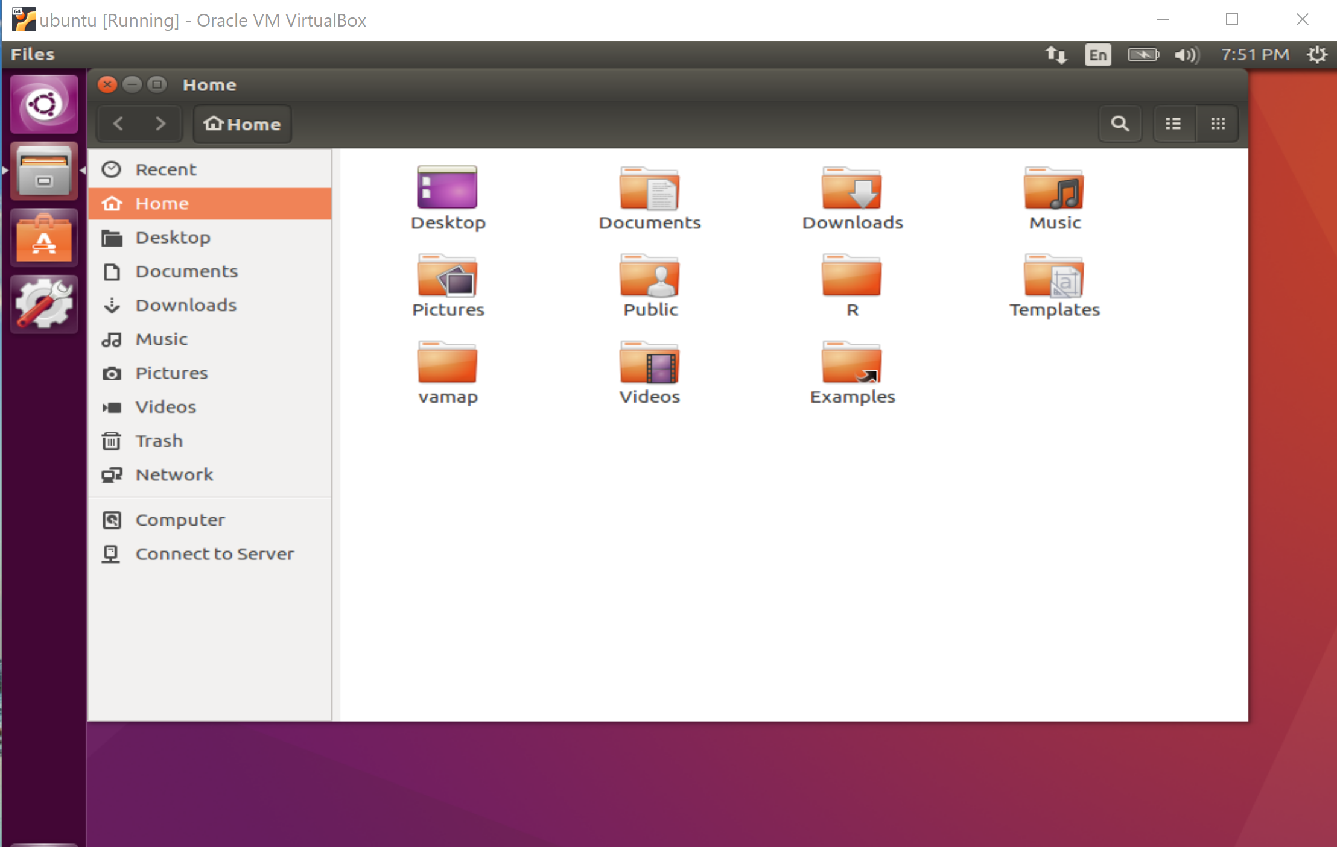

Slide 3
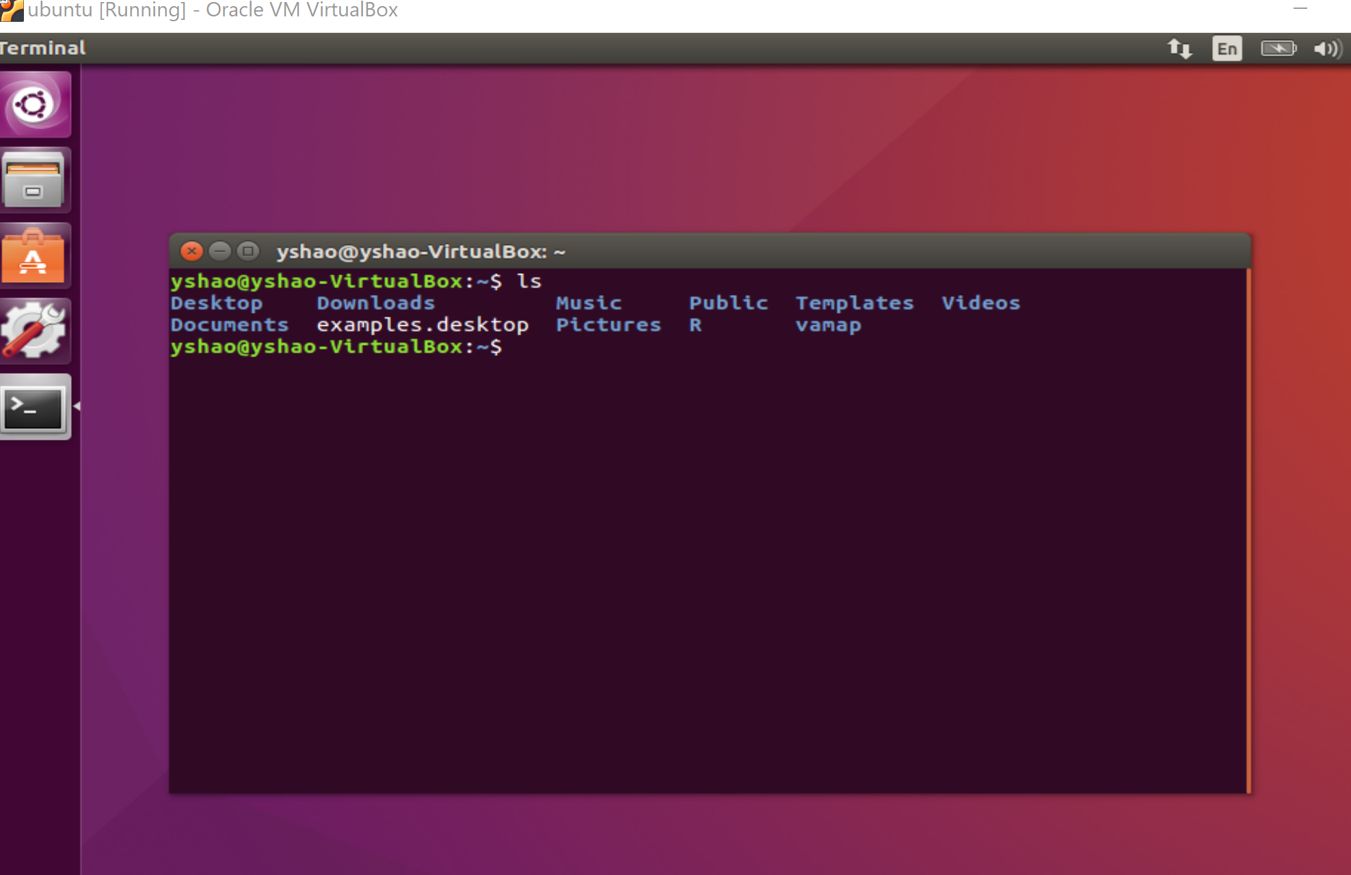

Slide 4


Slide 5
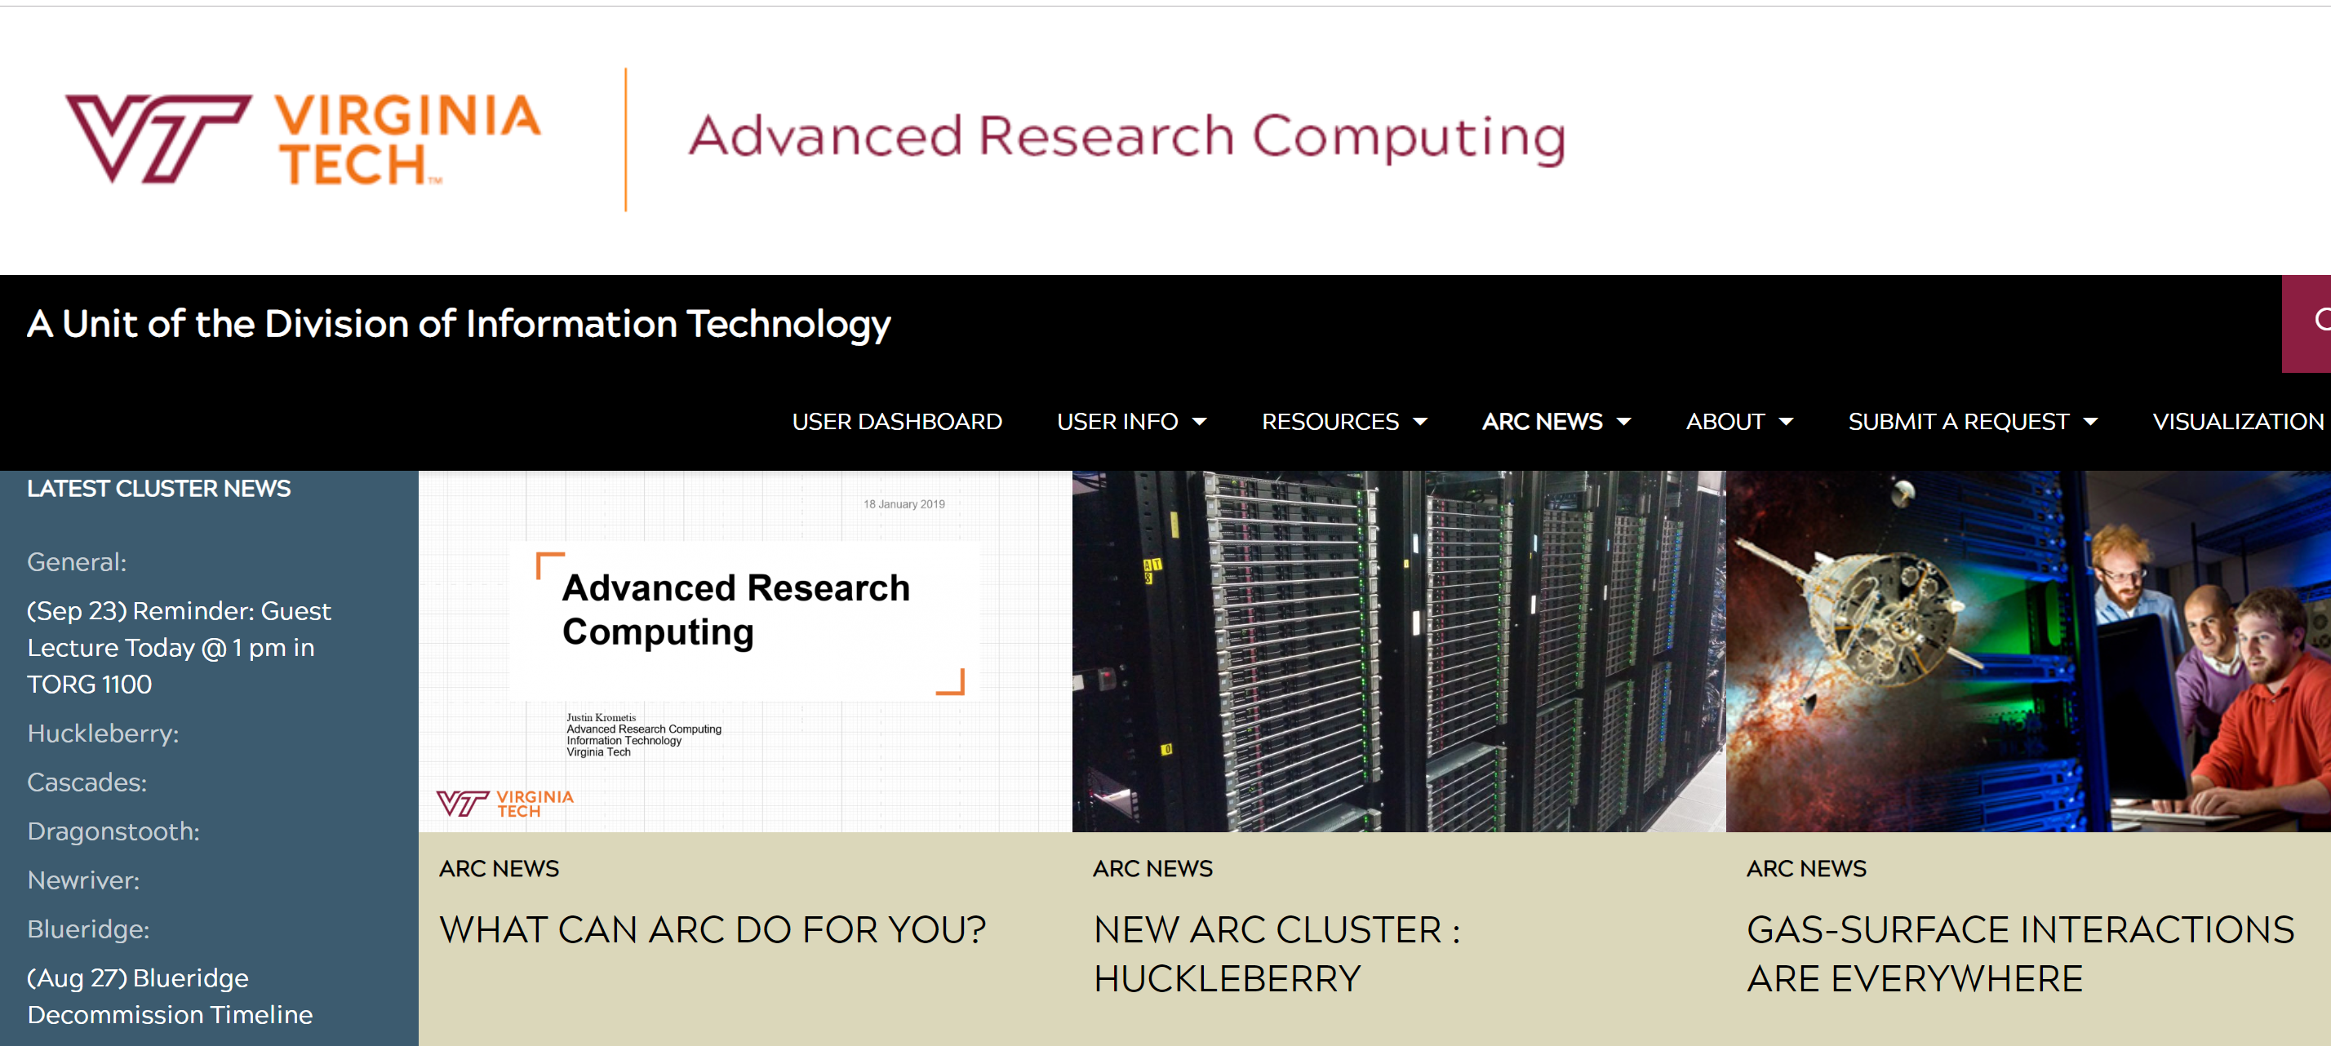

Slide 6
ARC High Performance Computing
“Advanced Research Computing (ARC) provides centralized support for research computing by building, operating and promoting the use of advanced cyberinfrastructure at Virginia Tech. ARC delivers a comprehensive ecosystem consisting of advanced computational systems, large-scale data storage, visualization facilities, software, and consulting services. ARC provides education and outreach services through conferences, seminars, and scientific computing courses. ARC seeks to help maximize research productivity at Virginia Tech through interdisciplinary collaborations that connect researchers to new opportunities in computing and data driven research as they occur. By fostering strategic partnerships with the public and private sector, ARC serves to cultivate an entrepreneurial spirit around advanced computing infrastructure as a platform for collaboration and helps secure the position of Virginia Tech as a leader in education and research.”
https://www.arc.vt.edu/wp-content/uploads/2018/10/ARC_Intro_2018.pdf

Slide 7
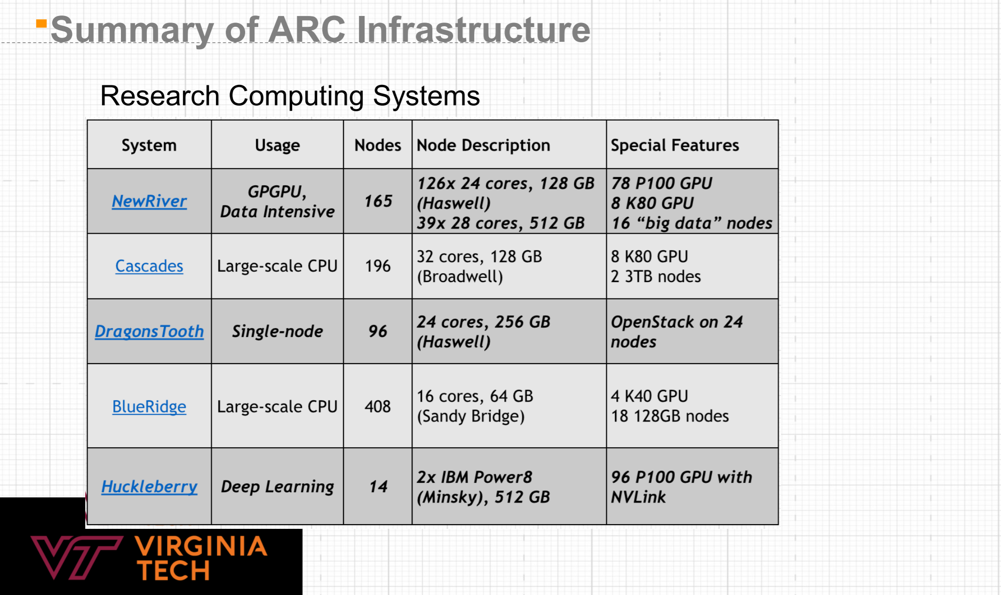
ARC High Performance Computing
CentOS Linux
Red Hat linux
https://www.arc.vt.edu/wp-content/uploads/2018/10/ARC_Intro_2018.pdf

Slide 8
Several free SSH (Secure Shell)Client can be used to access ARC-VT:
Putty: https://www.putty.org/
SSH Secure Shell Client: available through Canvas/lab7/lab7a
GIT Bash

Slide 9

A quick demo on ssh

Slide 10

Use GIT Bash to access ARC clusters

Slide 11
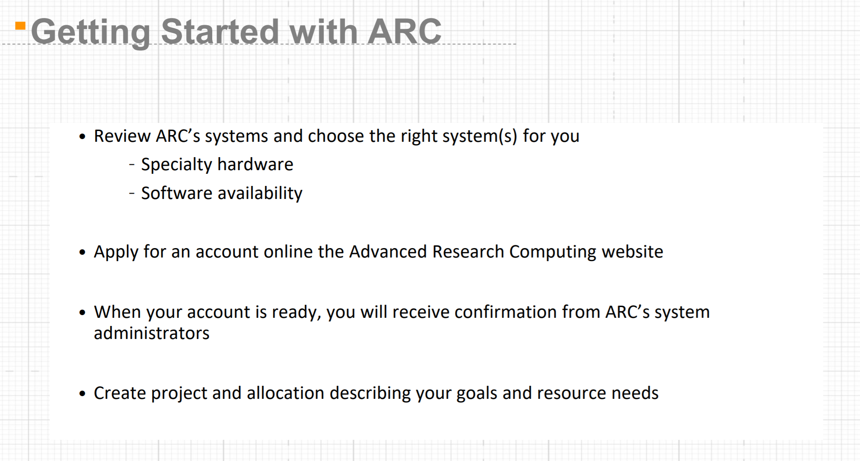
https://www.arc.vt.edu/wp-content/uploads/2018/10/ARC_Intro_2018.pdf

Slide 12
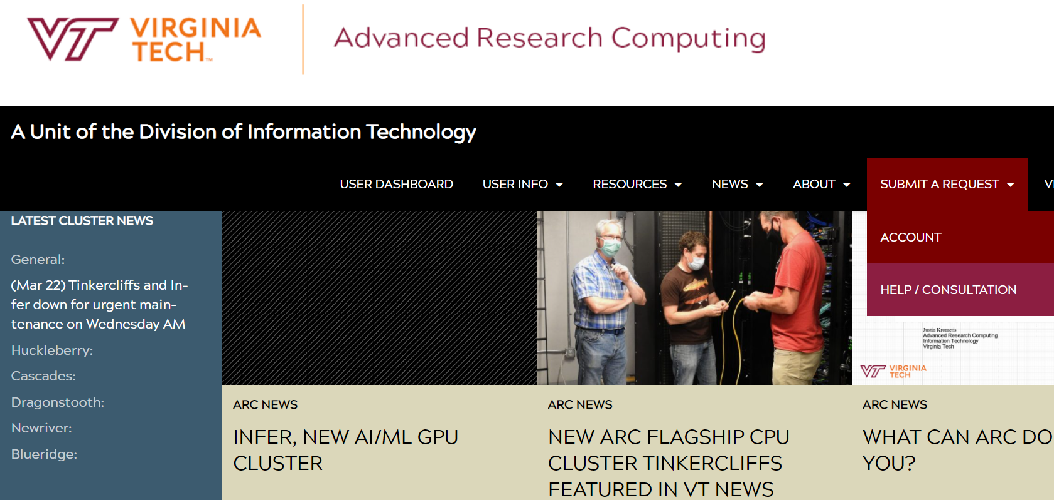
Submit A request: cascades
https://arc.vt.edu/

Slide 13
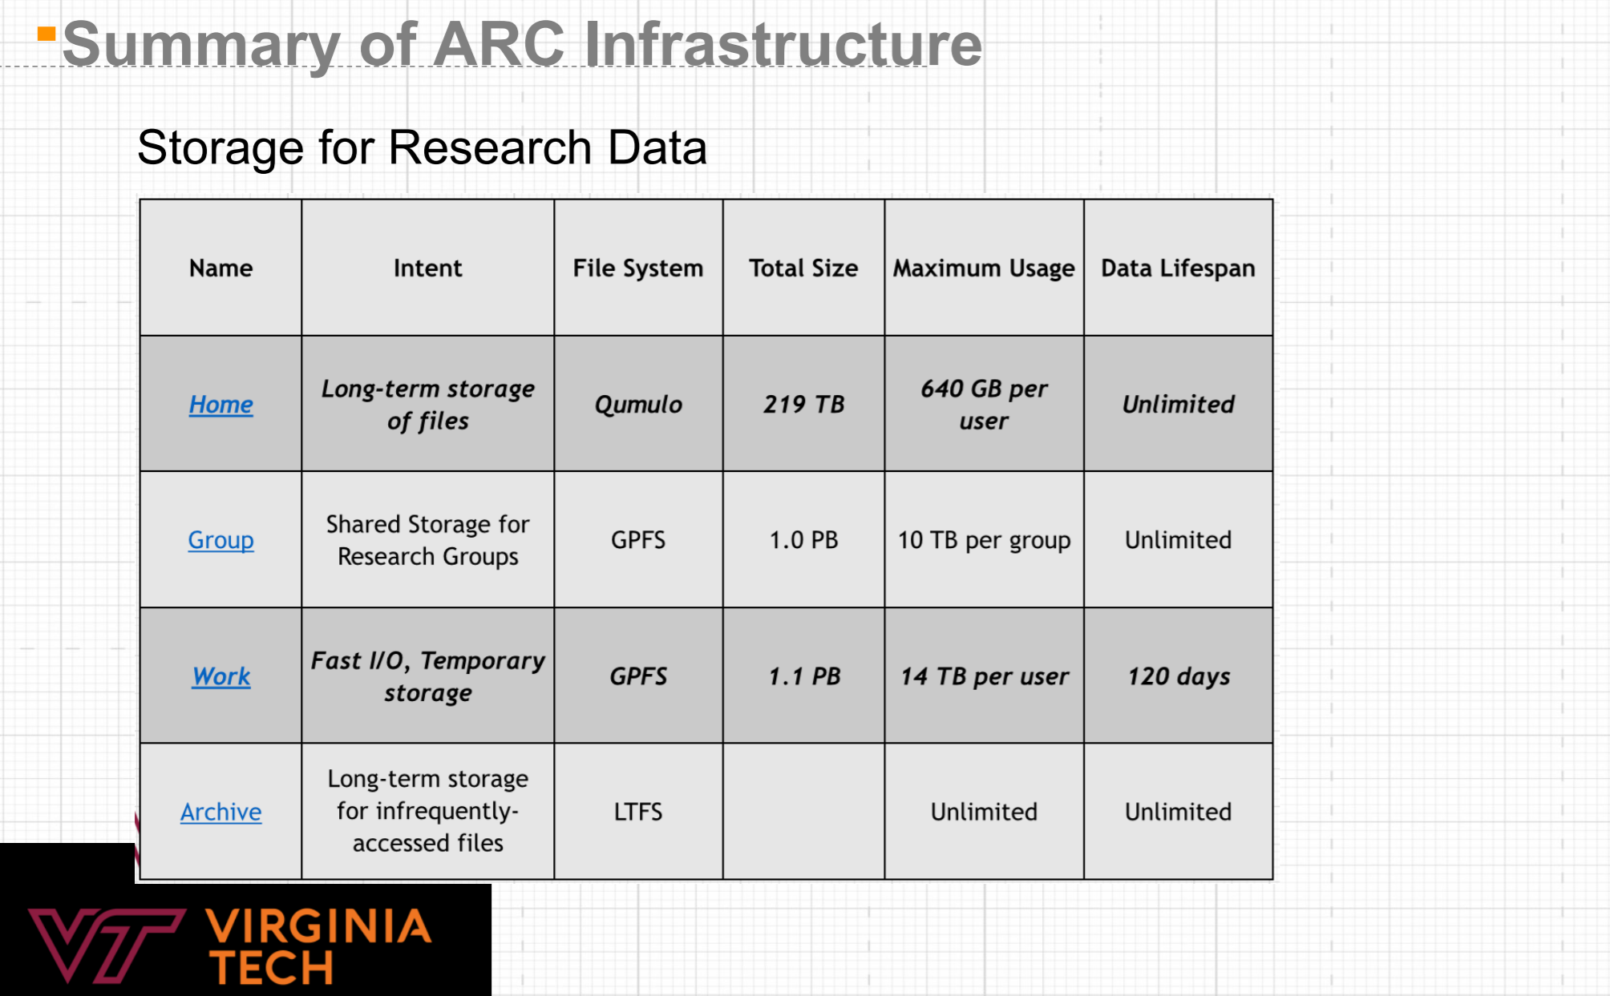
ARC High Performance Computing
https://www.arc.vt.edu/wp-content/uploads/2018/10/ARC_Intro_2018.pdf

Slide 14
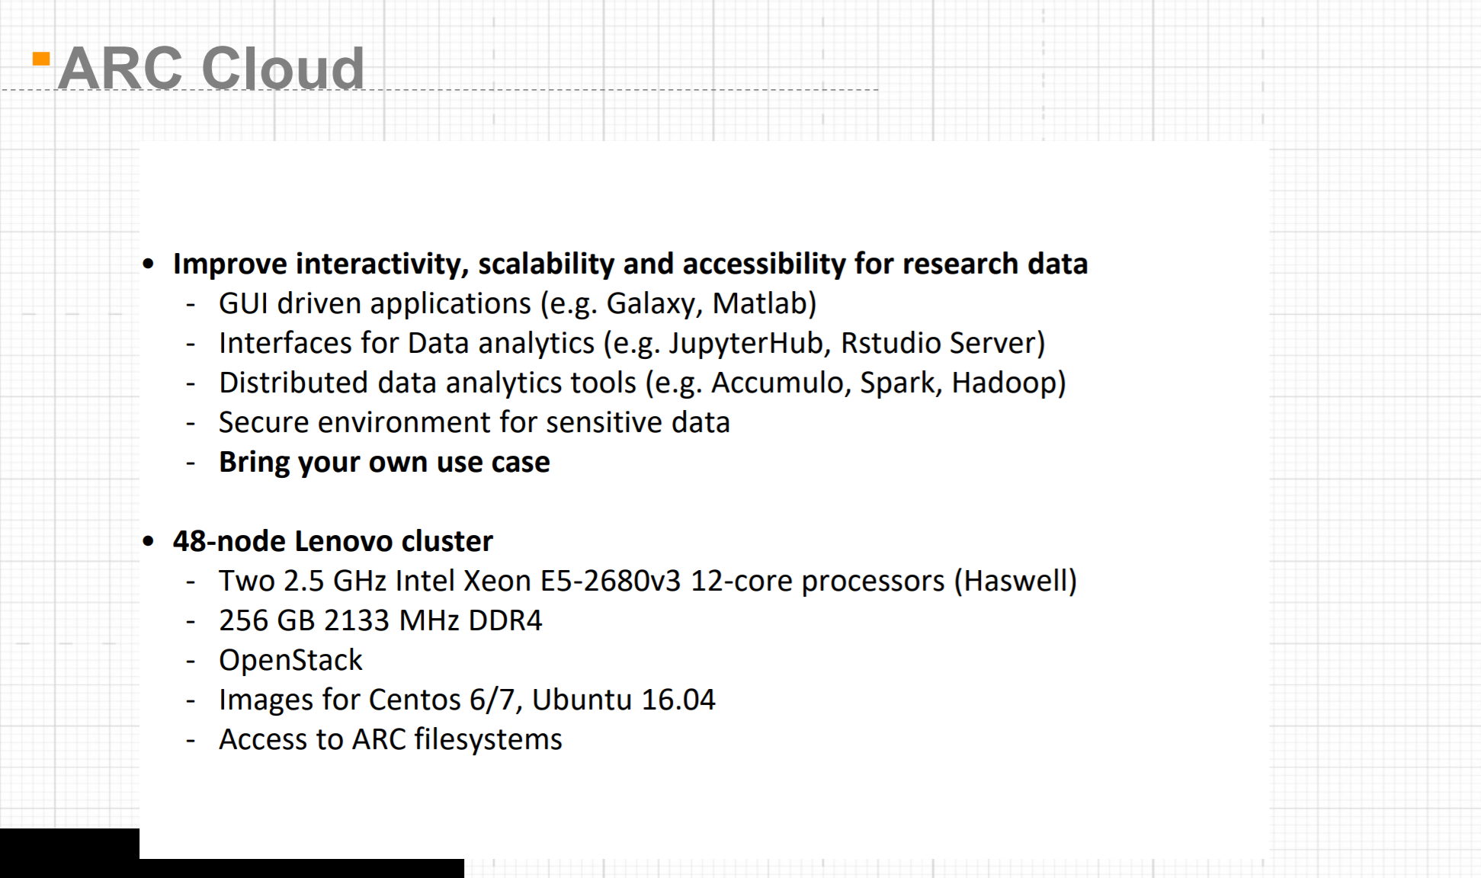

Slide 15
